Slide 1
Step Into Java:
Heaps/Priority Queues
Mr. Neat

Slide 2
Priority Queues
Is a data storage structure that allows retrieval of items by priority or rank.
Examples that would use this data structure:
In computer science, the smallest value is the highest priority

Slide 3
Priority Queue
Java has a PriorityQueue Interface
Its methods are:
  boolean IsEmpty()
  void add(Object)
  Object removeMin()
  Object peekMin()

Slide 4
Heaps
A heap is a binary tree with two additional properties:
  Completeness (all full except for the bottom level)
  Ordered (each node is smaller than its left and right sub-trees)

Slide 5
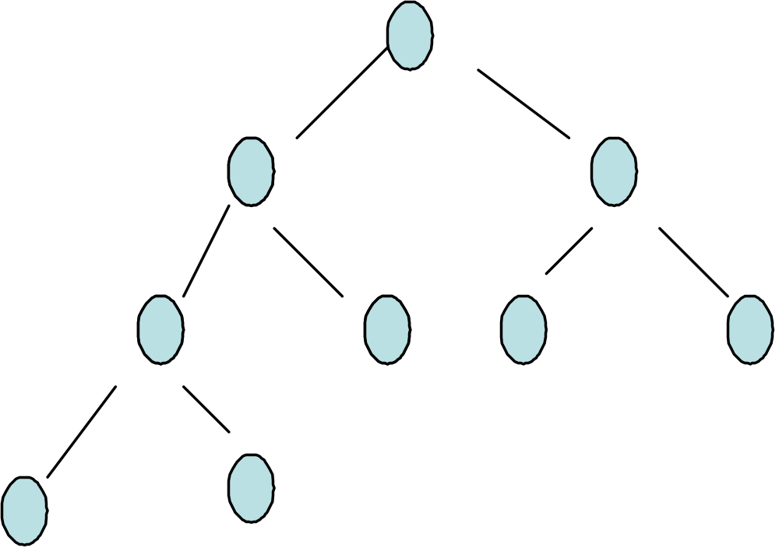
Recall a complete BT…
1
2
3
4
5
6
7
8
9

Slide 6
What If?
You remove the highest priority item (root)?
What if you add a new item?

